Slide 1
Foundations of Computing
(at Scale)
Max Hawkins

Slide 2
Computing

Slide 3
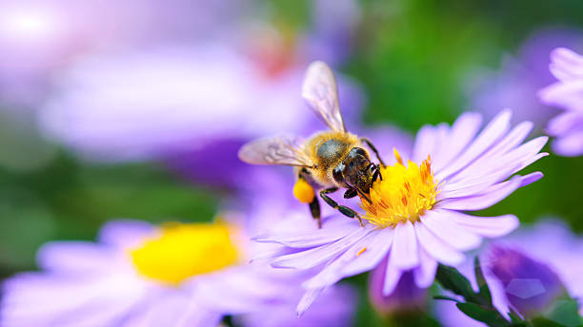
Information
Definition (a single choice of many from Merriam-Webster):
“knowledge obtained from investigation, study, or instruction”
Examples:
Binary data in memory
Output of an algorithm
Collection of webpage visits
Feeling of heat from the stove
Sight of a flower

Slide 4
Information Processing is Critical
Examples with computing are bountiful and pervasive
Usually dictated by Input -> Processing -> Output
Biological beings (like us) are doing this all the time too
Feel hunger. Look in fridge for food. Open pickle jar. Eat pickle. … Feel full.
Each species’ experience is affected by its umwelt
Definition: The specific way organisms of a particular species experience the world
Book recommendation: An Immense World by Ed Yong

Slide 5
Standardizing Common Information Processes
Most humans have a general notion of less, more, equal, sets, etc.
A toddler recognizes when you steal all its cheerios
However, settling a bill would be harder if both sides didn’t share understanding
Introducing…MATH!
Math serves as a common representation for many useful things
Common standards -> Easier communication and collaboration
Number systems, operations, written form (mostly standardized)
Information Processing using Math: Computing
Definitions:
To determine especially by mathematical means
To determine or calculate by means of a computer

Slide 6
Computation
Computation = Information Processing + Math?
Humans evolved in a world without our explicit formulations of math
—> The human brain is pretty bad at math
Maximum working memory of 5 - 9 ‘numbers’ at any time
Forgetful, imprecise, hard to scale, unreliable, and long manufacturing/training time…
Pen/paper, the abacus, and calculators are good but not great
Information Processing is Valuable -> Design an Optimized Tool:
The Computer?

Slide 7
Computer Building Blocks
Digital - Individual states of 0 or 1 (binary digits or bits)
Electrical - Uses electricity/voltage levels for this encoding
Vacuum tubes (too big and energy intensive)
Transistors
Fundamental building block of digital computing for the past ~70 years

Slide 8
Computing at Scale

Slide 9
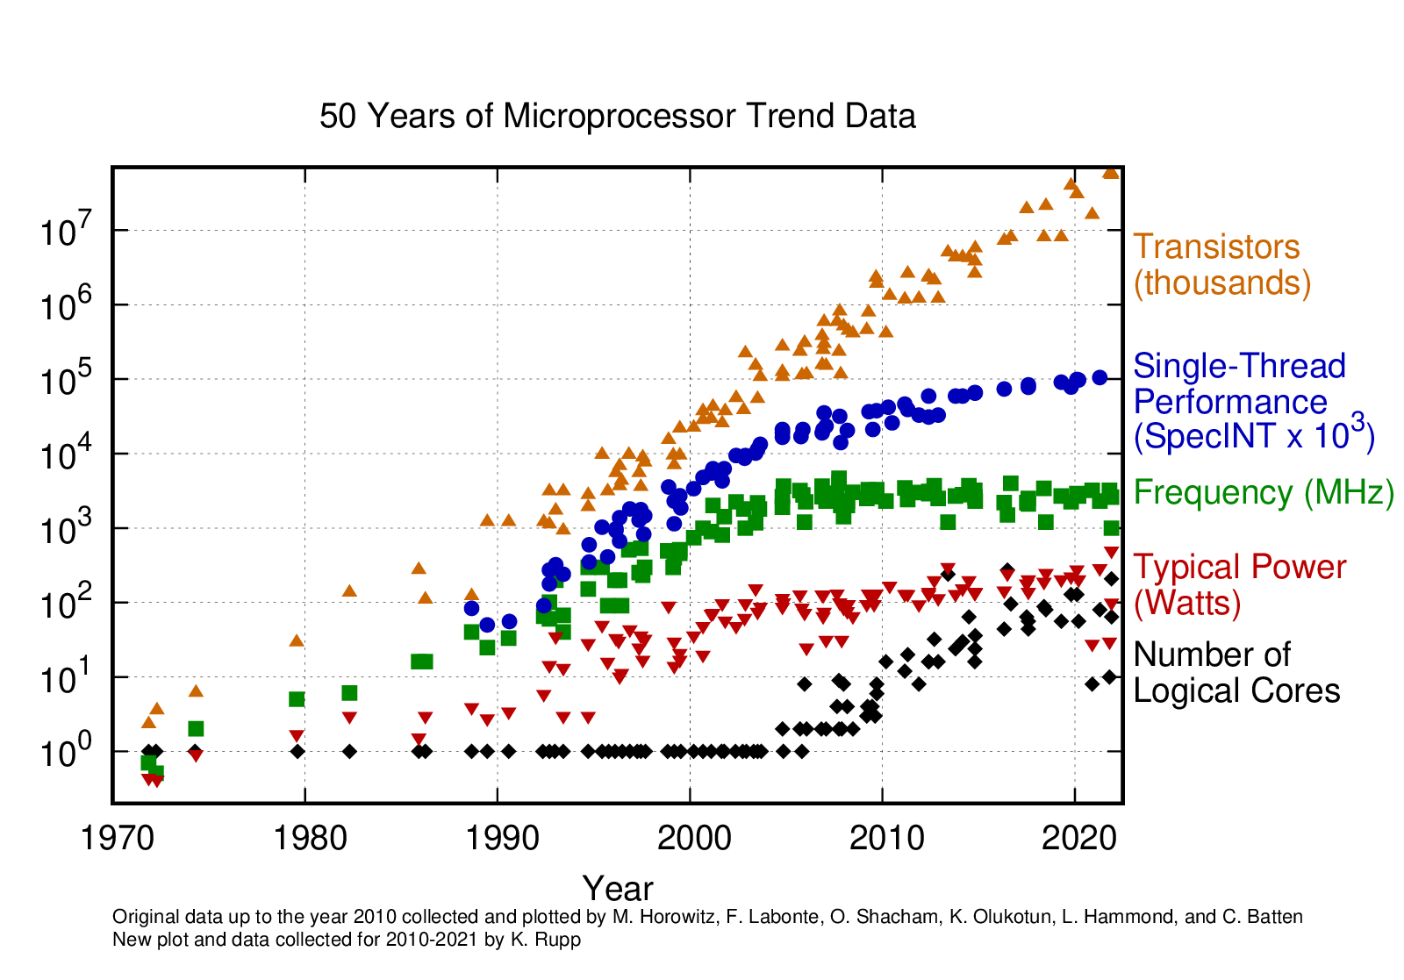
Scaling
Transistors got smaller, cheaper, and more power efficient
→ Computing performance increased
Moore's law:
The number of transistors on a microchip doubles every ~2 years
How does transistor density play a role?
Dennard Scaling:
Power density of transistors stays constant with size
Same unit chip area → Same power draw
Where does this take us?

Slide 10
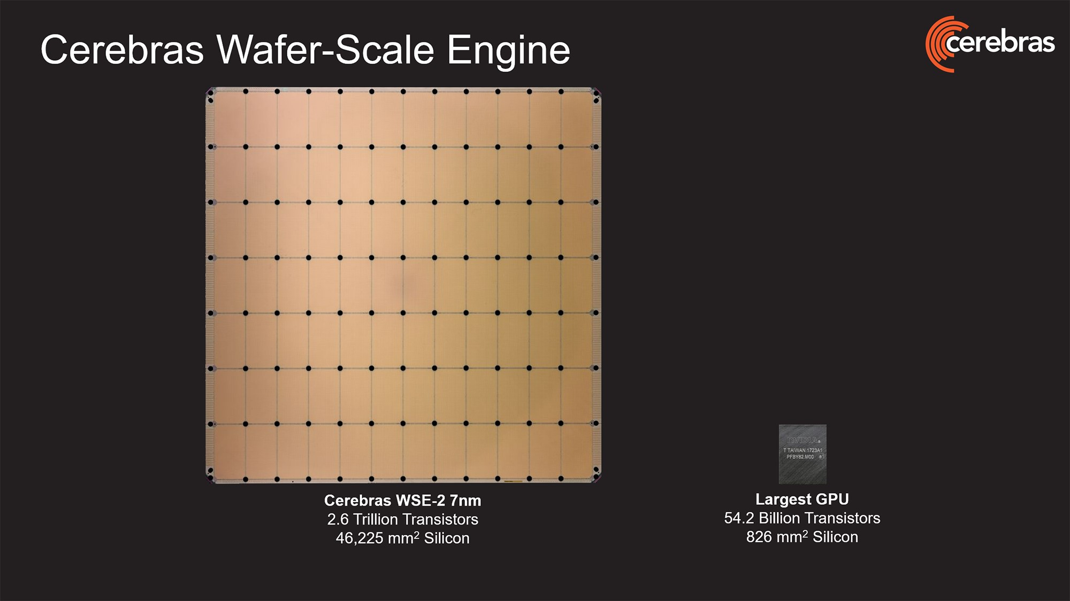

Slide 11
Still Not Enough?
Bigger, faster, more expensive, adds more cores
Not just one device on a system -> local interconnect (PCIe)
Dual socket motherboards
Specialized hardware (GPUs, TPUs, DPUs, etc)
Scale out → Multiple nodes → Interconnect
Transistor, chiplet, chip, device, node, rack, aisle, datacenter, …
From atomic to global scales

Slide 12
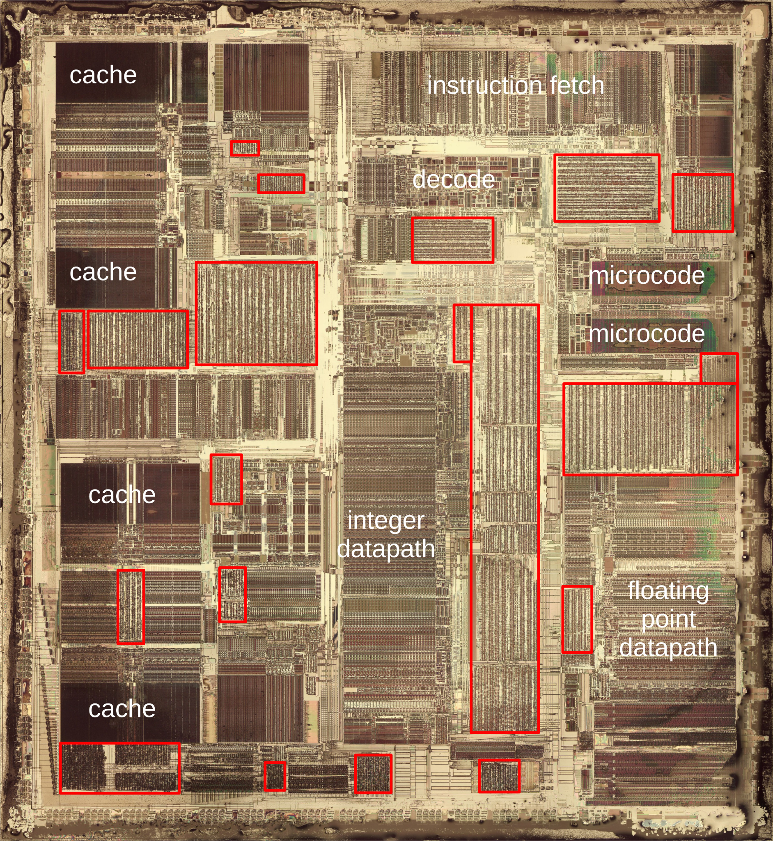
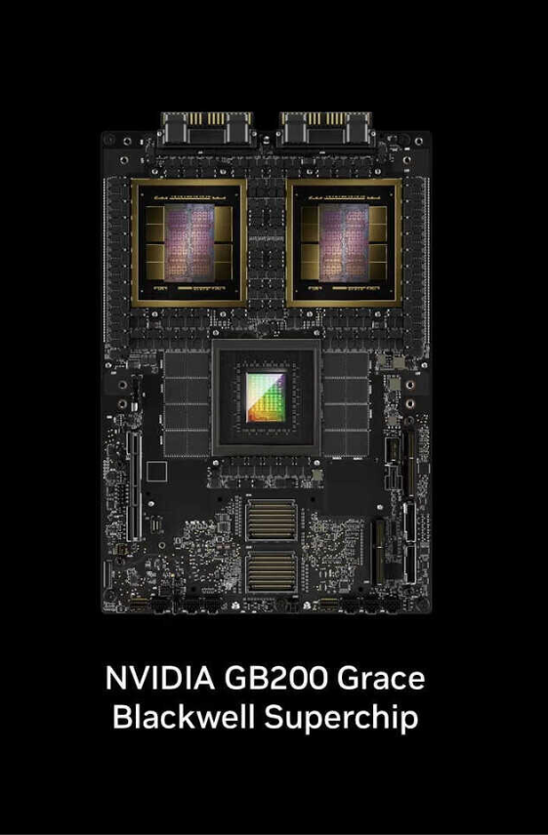
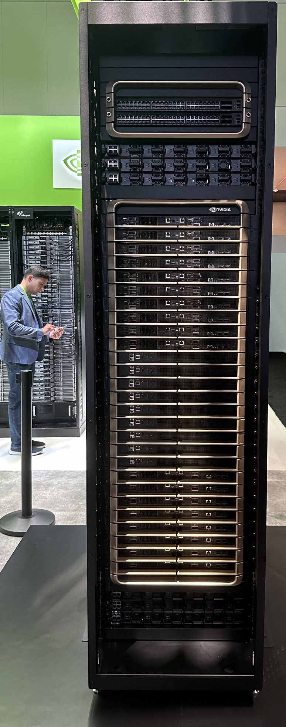
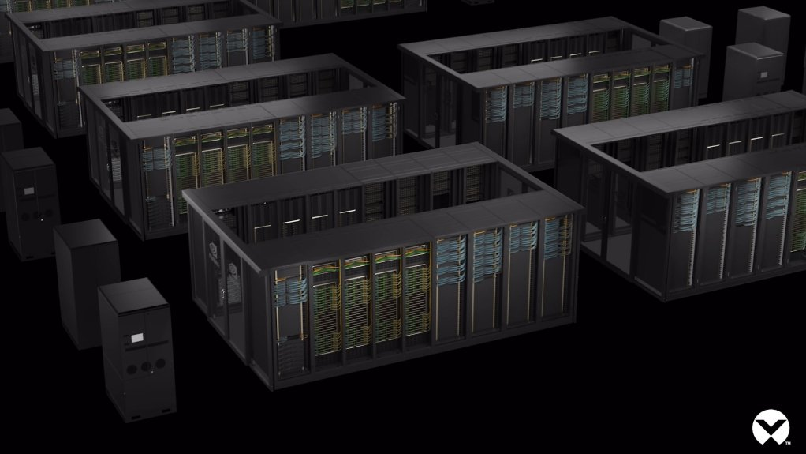
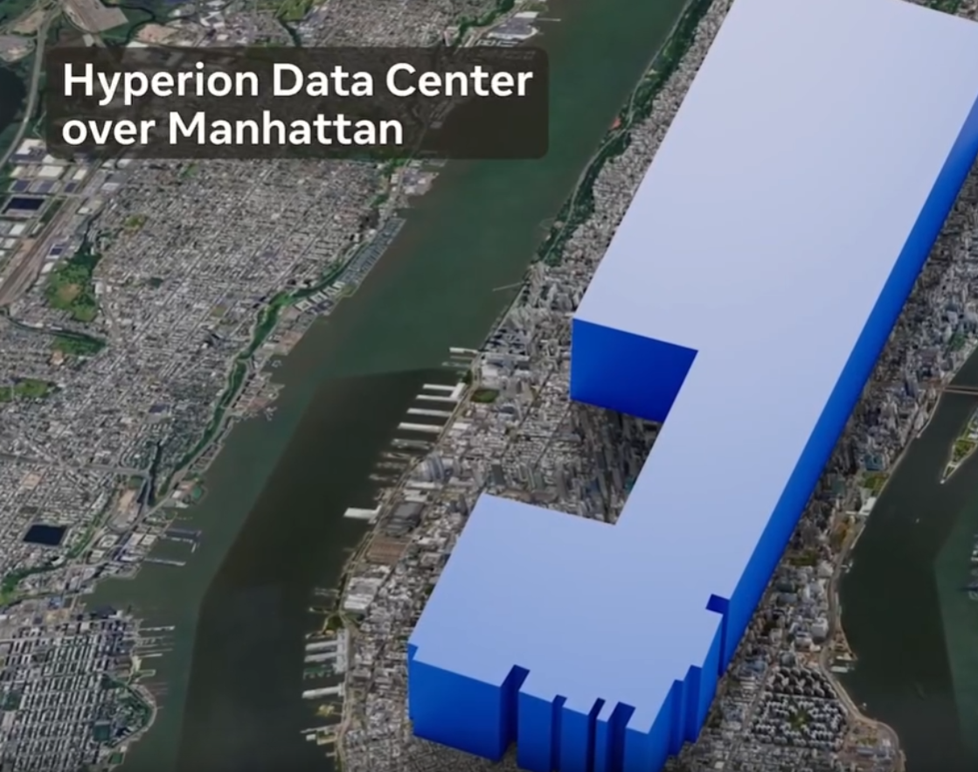
Ken Shirriff’s blog
TechPowerUp
The Register
Engineering News
Data Center Dynamics

Slide 13
Unprecedented Scale and Impact
Before AI, largest supercomputers ~20 MW
US Federal HPC systems like Frontier, Aurora, and El Capitan
Meta plans to build a 5 GW AI DC (Hyperion)
250 times larger!
A traditional nuclear power plant outputs ~ 1 GW of power
Massive Power + Inefficiencies = Large Cooling Demand
Evaporative water cooling is effective but water consuming
Example: 1 DC in Georgia will evaporate up to 6 million gallons of water per day
Equivalent to ~600-700 thousand average US people

Slide 14
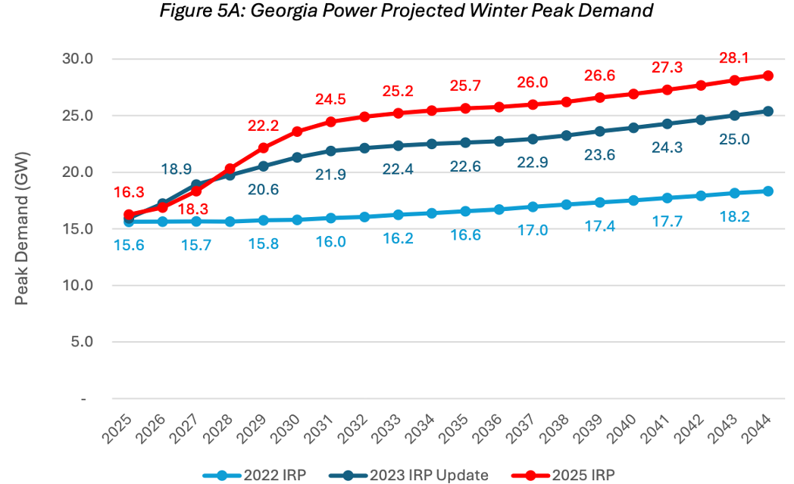
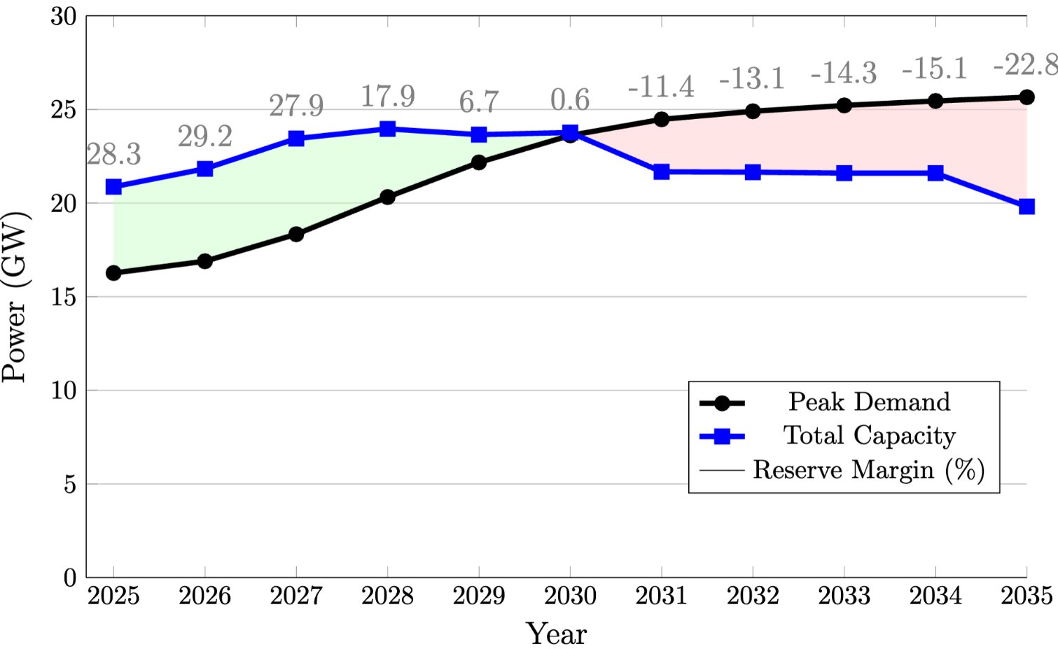
Power Impacts
AI demand is causing surging power demand
Right: Georgia Power data
Top: The demand increases came quick
Bottom: Insufficient power generation
Also, AI training power swings
At scale, training power can fluctuate 100s of MWs in seconds
Our grid wasn’t built for this
AI inference has a similar effect
Prefill vs decode phases
But the scale of inference synchronization is much smaller → negligible impact

Slide 15
Water Impacts
Secondary water consumption: Energy generation
Thermoelectric power generation is the largest consumer of water in the US
Need to factor in water consumption of the power sources
What happens in a drought?
Who gets priority to water?
Example: That Georgia DC mentioned before is more than doubling its county’s water consumption
Are data centers ‘critical’ infrastructure like hospitals?
Less constraints imposed during water scarcity
What are the tradeoffs of building a water-efficient data center?
Power, cost, efficiency, etc

Slide 16
Carbon Footprint
Building, operating, and decommissioning DCs all have environmental impacts
AI demand surge → Rush to build DCs → Build energy plants quick
Natural gas plants are in demand due to large power output and relatively quick build-out
AI has a large carbon footprint

Slide 17
Future of Computing at Scale
What is the limit to scaling computing?
Is there one?
Should there be?
Jevons Paradox
Increasing resource efficiency induces increased demand and overall resource consumption
We have 70 years of data demonstrating this effect on computing
NOT like light production (e.g. candles to LEDs) where our eyes limit total demand
What is your personal value weighting of computing?
How much are you willing to spend ($, power, water, carbon, time, etc) for AI/HPC work?

Slide 18
Computing is valuable,
operating at immense scale,
and its future can be shaped by you.
What future do you want to live in?

